Slide 1
Benjamin of Tudela Itinerary

Slide 2
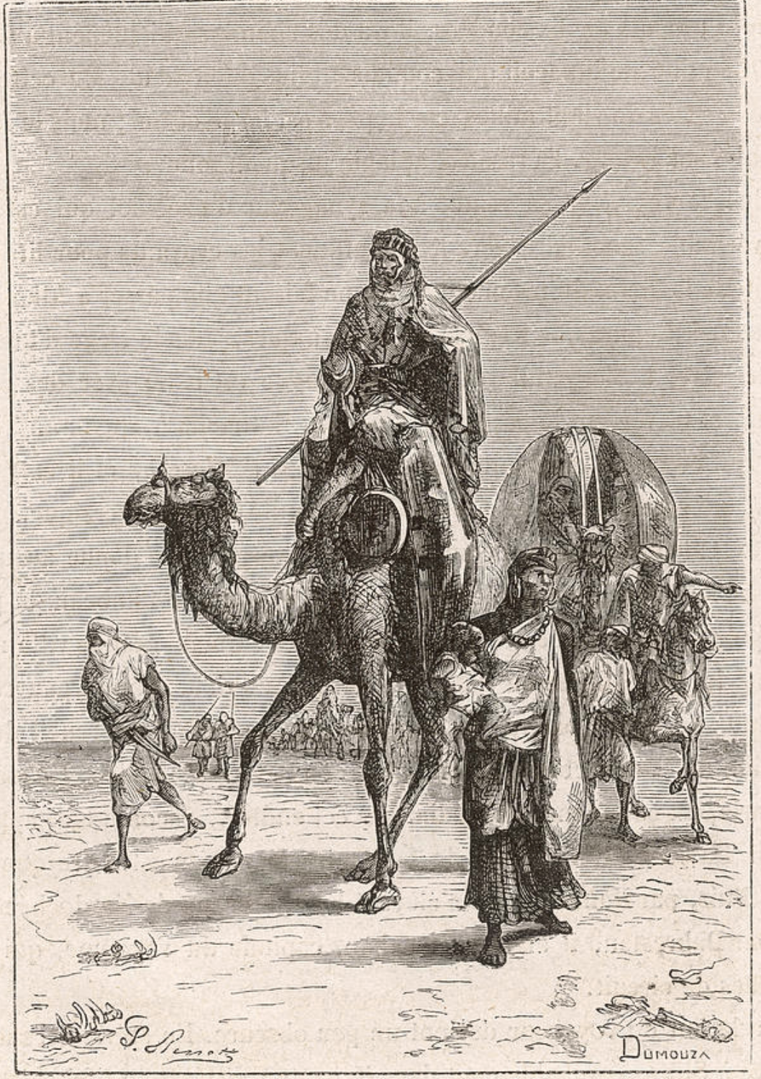
Benjamin of Tudela
(fl. 12th century)
Dumouza (19th c.)
Engraving

Slide 3
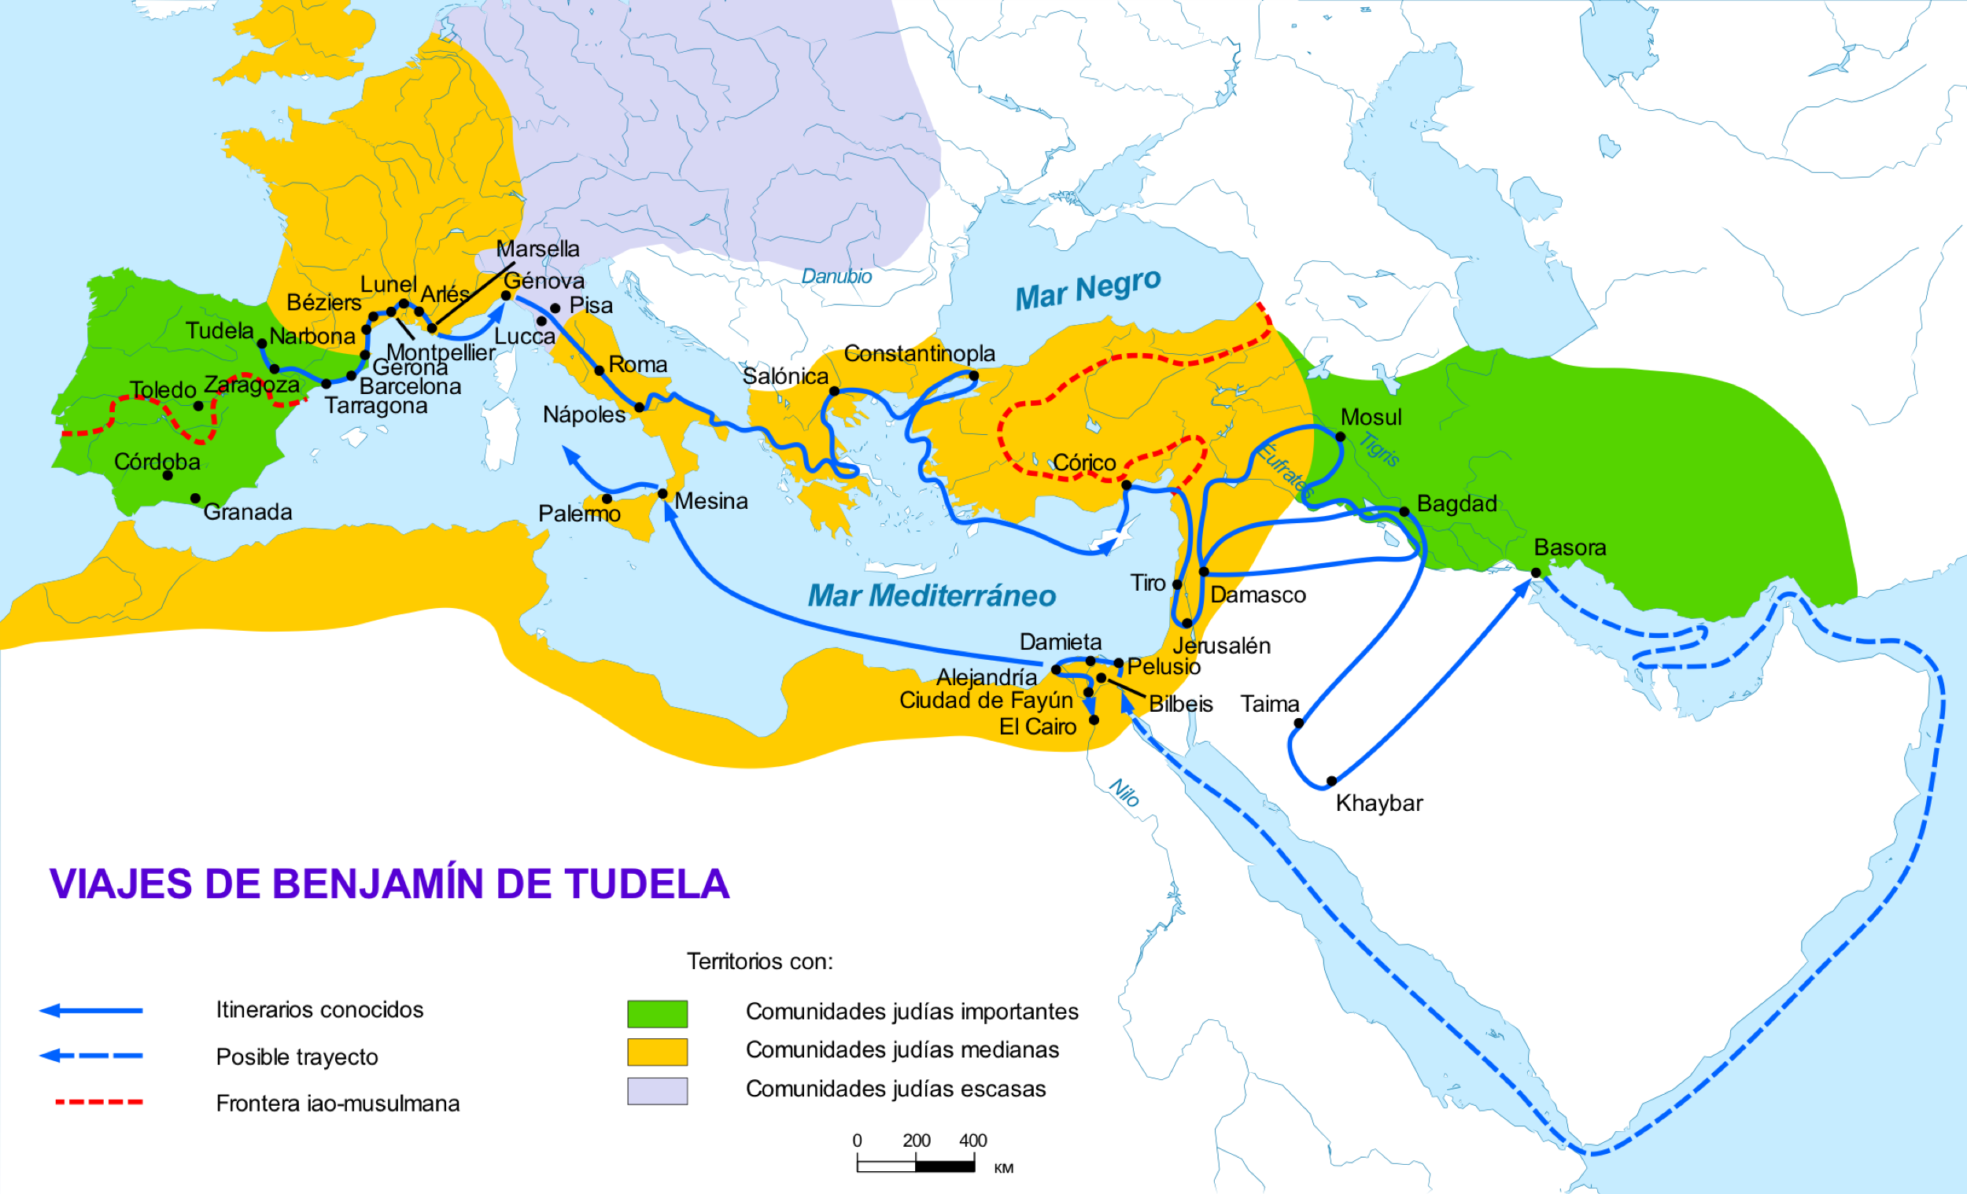
Itinerary of Benjamin of Tudela

Slide 5
Summary Why summarize?
Who is the audience for your writing?
Assume your audience is an intelligent, public reader who is not familiar with your sources
Your readers need to know what you are writing about, without having to read the source themselves
Not every essay will require a summary, but I am asking you to do so for this course

Slide 6
Summary What is a summary?
A concise, accurate representation of the source in your own words
Objectively represents the source
Even if you disagree with the author’s point, the summary does not reflect this.
Instead, use neutral terms such as ‘argue’, ‘describe’, ‘state’, ‘explain’, etc.
Does not interpret or analyze. That will come later in your essay.
Contains only elements of the source that are important for your readers’ understanding of the source and for your essay as a whole.
You may choose to exclude certain parts of the source from your summary
As your essay progresses, you will need to return to your summary and make sure the elements you mention are included.

Slide 7
Summary Summarizing the Itinerary
What elements might you include in a summary of the Itinerary?
Literal description of his itinerary (brief!)
Recurring themes of the text
Elements/ideas that Benjamin continuously focuses on
Important specific moments
Brief quotations to add flavor to the summary
Try to strike a balance between the general and the specific
And between the narrative and the thematic

Slide 8
Summary First sentence
The first sentence of your essay is very important, as it situates your reader for the essay as a whole
It should probably include:
Full name of the author
Title of the source
Approximate date of the author or text
Genre of the source (letter, article, poem, travelogue)
A brief statement describing what the source is about

Slide 9
Summary First Sentence
In the Itinerary, Benjamin of Tudela describes his travels around the Mediterranean.

Slide 10
Summary First Sentence
In his Itinerary, Benjamin of Tudela, a Jew from Navarre in northern Spain, “journeyed first from my native town to the city of Sargossa, and thence by way of the Riber Elbro to Tortosa” (59).

Slide 11
Summary First Sentence
In the late 1160s, Benjamin of Tudela wrote a description of his travels to Jewish communities called the Itinerary.

Slide 12
Summary First Sentence
Benjamin of Tudela’s Itinerary, a travelogue of his travels around the Mediterranean in the late 1160s, attempts to describe the peoples and stories of the cities he visits.

